Slide 1
Direct and Cross Examination
Maj Adam Bentz

Slide 2
Direct Overview
Preparation
Direct Principles
Redirect

Slide 3
Direct Examination
What’s the purpose of this witness?:
Facts I need for closing
Lay foundation/introduce evidence
Set the scene?
Corroboration?
Organization:
Witness Order
Chronological/Topical/Geographical

Slide 4
Preparation – Meeting
Get to know your witness!
Explore and explain inconsistencies
Review Statements
Practice, but don’t overdo it
Do the negatives of calling the witness outweigh the positives?
Notes:
4
Know your witness – and structure your direct accordingly!
Important witness – may want to meet with him a couple of times before going in depth on facts
Going to need to be prodded for more, or throttled back?
Demeanor? - shrinking violet or boastful?
Pace – good witness or bad?
Develop rapport, but don’t be the witness’s shoulder to cry on
Be careful not to “draft testimony”
Are you contributing to the case or buying yourself a headache?
Sponsorship theory.
Take into account potential defense arguments created if you don’t call the witness

Slide 5
Preparation Tips
Prepare witness file
Contains relevant documentary evidence
Your notes
Agent/investigator notes
Every written statement made by witness
Military Evidentiary Foundations
Refreshing Recollection – MRE 612
Past Recollection Recorded – MRE 803(5)
Prepare Redirect:
Have a point other than rehashing your direct
Don’t emphasize defense’s questions
Be prepared for objections and have your response
Notes:
5
Gather the materials that you will need. If the witness has made a written statement, have it handy and several clean copies of it in case your need to use the statement to refresh the memory of the witness. Have the foundation questions ready for this possibility (present recollection refreshed) and for the possibility that the witness will freeze and you will have to establish the foundation for reading the statement into the record.
Writing used to refresh memory of a witness on the stand – MRE 612
Past recollection recorded – MRE 803(5) “…once had knowledge but now has insufficent recollection to enable the witness to testify fully and accurately, shown to have been made or adopted by the witness when the matter was fresh in the witness’ memory and to reflect that knowledge correctly. If admitted, the memorandum or record may be read into evidence…but may not itself be received as an exhibit unless offered by an adverse party.” Remember, mark the exhibit as an Appellate Exhibit.
-Have witness statements marked as an appellate exhibit before trial
In your trial preparation materials, you should have a copy of the foundation for basic issues that come up during trial. I always carried my foundation book into trial with me. While being able to do it without notes is the hallmark of many great orators – as a prosecutor you have a job to do. If notes are needed to ensure you are able to do your job – then notes it is.

Slide 6
Art 46: Interviewing Victims
DC SHALL make request to interview victim through TC
Upon notice of name of victim who TC intends to call at Art 32 or CM
3. TC/SVC/VA present (per Victim request)
Notes:
6
Gather the materials that you will need. If the witness has made a written statement, have it handy and several clean copies of it in case your need to use the statement to refresh the memory of the witness. Have the foundation questions ready for this possibility (present recollection refreshed) and for the possibility that the witness will freeze and you will have to establish the foundation for reading the statement into the record.
Writing used to refresh memory of a witness on the stand – MRE 612
Past recollection recorded – MRE 803(5) “…once had knowledge but now has insufficent recollection to enable the witness to testify fully and accurately, shown to have been made or adopted by the witness when the matter was fresh in the witness’ memory and to reflect that knowledge correctly. If admitted, the memorandum or record may be read into evidence…but may not itself be received as an exhibit unless offered by an adverse party.” Remember, mark the exhibit as an Appellate Exhibit.
-Have witness statements marked as an appellate exhibit before trial
In your trial preparation materials, you should have a copy of the foundation for basic issues that come up during trial. I always carried my foundation book into trial with me. While being able to do it without notes is the hallmark of many great orators – as a prosecutor you have a job to do. If notes are needed to ensure you are able to do your job – then notes it is.

Slide 7
Preparation Tips
Interview witness first if at all possible!
Keep contact with witness prior to trial
Re-interview witness after they speak with other side
Notes:
7
Gather the materials that you will need. If the witness has made a written statement, have it handy and several clean copies of it in case your need to use the statement to refresh the memory of the witness. Have the foundation questions ready for this possibility (present recollection refreshed) and for the possibility that the witness will freeze and you will have to establish the foundation for reading the statement into the record.
Writing used to refresh memory of a witness on the stand – MRE 612
Past recollection recorded – MRE 803(5) “…once had knowledge but now has insufficent recollection to enable the witness to testify fully and accurately, shown to have been made or adopted by the witness when the matter was fresh in the witness’ memory and to reflect that knowledge correctly. If admitted, the memorandum or record may be read into evidence…but may not itself be received as an exhibit unless offered by an adverse party.” Remember, mark the exhibit as an Appellate Exhibit.
-Have witness statements marked as an appellate exhibit before trial
In your trial preparation materials, you should have a copy of the foundation for basic issues that come up during trial. I always carried my foundation book into trial with me. While being able to do it without notes is the hallmark of many great orators – as a prosecutor you have a job to do. If notes are needed to ensure you are able to do your job – then notes it is.

Slide 8
Oath
M.R.E. 603 & R.C.M. 807
“Do you (swear) (affirm) that the evidence you shall give in the case now in hearing shall be the truth, the whole truth, and nothing but the truth, (so help you God)?”
Notes:
Take a look at R.C.M. 807 Discussion section, what is listed under A, B, C, etc in the discussion section?
Who gives the oath to the witnesses?
What about defense witnesses?
Take control of the witness, give him the oath, stand in front of the witness and make that witness swear to tell you the truth. You’ll hear throughout the MJ lectures and probably from the STCs you work with, take control of the courtroom. It’s our courtroom, our evidence, our case…same thing with WIT oaths.
Memorize this oath and to start, let’s recite it.

Slide 9
Conduct the Direct
Introductory questions
ID accused – Where?
Remind co-counsel to take notes
LISTEN to witness!!
Eye contact
Follow-up the answer
Check with co-counsel for any missed points
Notes:
9
Lead in the courtroom…preparation, knowledge, confidence…leadership attributes. Having exhibits pre-marked, handling exhibits competently, responding to objections quickly, but thoughtfully are examples of
Be ready with the order of your witnesses. If needed, ask the MJ to exclude the witnesses from the courtroom (MRE 615).
The bailiff will go get the witness. Direct them to the witness stand. Swear them in. Ask the introductory questions:
Please state your name and unit of assignment for the record.
Do you know the accused, SrA Arthur L. Cohran?
Please identify him for the record.
Correct identification of the accused.
Before you end, ask your co-counsel if you have missed any points….
___________
Rule 615. Exclusion of witnesses
At the request of the prosecution or defense the military judge shall order witnesses excluded so that they cannot hear the testimony of other witnesses, and the military judge may make the order sua sponte. This rule does not authorize exclusion of (1) the accused, or (2) a member of an armed service or an employee of the United States designated as representative of the United States by the trial counsel, or (3) a person whose presence is shown by a party to be essential to the presentation of the party’s case, or (4) a person authorized by statute to be present at courts-martial, or (5) any victim of an offense from the trial of an accused for that offense because such victim may testify or present any information in relation to the sentence or that offense during the presentencing proceedings.
As a general rule, witnesses are sequestered so they cannot hear the testimony of other witnesses. M.R.E. 615. Either party may invoke the rule or the military judge may order exclusion sua sponte. There are four common exceptions to the general rule:
The Accused: The accused has a Sixth Amendment right to remain in the courtroom even if he or she will testify. M.R.E. 615(1).
Designated Representatives of the United States: Essentially, a designated representative acts as a member of the prosecution team to assist the trial counsel. E.g., an investigator who assisted the trial counsel investigate the case may sit at counsel’s table throughout the trial.
A Person Whose Presence is Shown by a Party to be Essential to the Presentation of the Party’s Case: Expert witnesses, or an expert who has been properly appointed to the prosecution or defense “team,” might also be covered by this exception (note that such experts usually do not testify as witnesses). M.R.E. 615(3).
The Victim: A victim may be present at all public court-martial proceedings unless the military judge determines that testimony by the victim would be materially affected if the victim heard other testimony at trial. Additionally, and apparently without regard to whether a victim’s testimony will be materially affected, a victim has the right to attend the trial and later testify during presentencing proceedings. M.R.E. 615(4) and (5) The “Rule of Completeness,” M.R.E. 106. Essentially, this rule prevents counsel from creatively “picking and choosing” helpful matters from a document and failing to disclose things that may be helpful to the opposing party. This is an important consideration, for example, in deciding whether or not to offer a prior inconsistent statement into evidence; it may do more harm than good.

Slide 10
Direct Principles
Don’t lead MRE 611(c)
Chronological/Topical/Geographical
Primacy and Recency
Draw the Sting? (timing)
Credibility
Background
Detail
Demeanor
Simple
Looping and Signposting

Slide 11
Looping
Q: What did you feel when he was cutting your throat?
A: I just felt pressure. I didn’t really feel pain. It was just pressure. I just knew I had been cut.
Q: And after you felt that pressure and you knew your throat was cut, what started going through your mind at that point?
A: I was praying to God. I told him that I wasn’t finished yet. I just kept saying, I’m not done yet. I wanted to tell my family that I loved them.
Notes:
11
This is a technique is used quite frequently. Many of you may do this already without knowing what it is called. It is a strong way to legally make a point. Effective looping results in the attorney (you) testifying during direct.
Here’s my caution with looping…do NOT loop every question. And when you loop, have a point to what you are using to loop. Like in this example, the point is to emphasize the throat cutting.

Slide 12
Headlining / Signposting
Q: How did it feel for you to be home from the hospital?
A: I was relieved. I was safe……
Q: I’m going to ask you a little bit about the scars that you have. What has it been like dealing with the scars?
A: It’s terrible. Kids will come up and ask me about it. You can’t tell a little kid what happened, so I just say I got hurt.
Q: Do you plan to do anything about the scars?
A: I want them gone, but they will probably be there because I am terrified of being put to sleep, of being under someone else’s control. I am terrified of someone having a knife close to my throat. I would rather live with them for the rest of my life than go through that.
Notes:
12
This is a popular tactic currently in litigation. Headlining makes it clear not only to the panel/judge where you are going (which may make objections less likely or even in the face of objections possibly prevail [overruled ruling] because the judge knows where you are going), it also lets the witness know. Remember they are nervous. Not matter how many times you have practiced they will mess up and/or forget. Headlining helps.

Slide 13
Direct Principles
Thinking and Feeling
Senses
Tell me more about…
Don’t ask “Why”
Positioning (Whose the star?)
Anticipate Objections/Refreshing
Prepare your witness
Listen

Slide 14
USE YOUR EVIDENCE
Notes:
Take a look at R.C.M. 807 Discussion section, what is listed under A, B, C, etc in the discussion section?
Who gives the oath to the witnesses?
What about defense witnesses?
Take control of the witness, give him the oath, stand in front of the witness and make that witness swear to tell you the truth. You’ll hear throughout the MJ lectures and probably from the STCs you work with, take control of the courtroom. It’s our courtroom, our evidence, our case…same thing with WIT oaths.
Memorize this oath and to start, let’s recite it.

Slide 15
Finish
Check w/ counsel
Do you have your elements?
Finish strong
Notes:
Take a look at R.C.M. 807 Discussion section, what is listed under A, B, C, etc in the discussion section?
Who gives the oath to the witnesses?
What about defense witnesses?
Take control of the witness, give him the oath, stand in front of the witness and make that witness swear to tell you the truth. You’ll hear throughout the MJ lectures and probably from the STCs you work with, take control of the courtroom. It’s our courtroom, our evidence, our case…same thing with WIT oaths.
Memorize this oath and to start, let’s recite it.

Slide 16
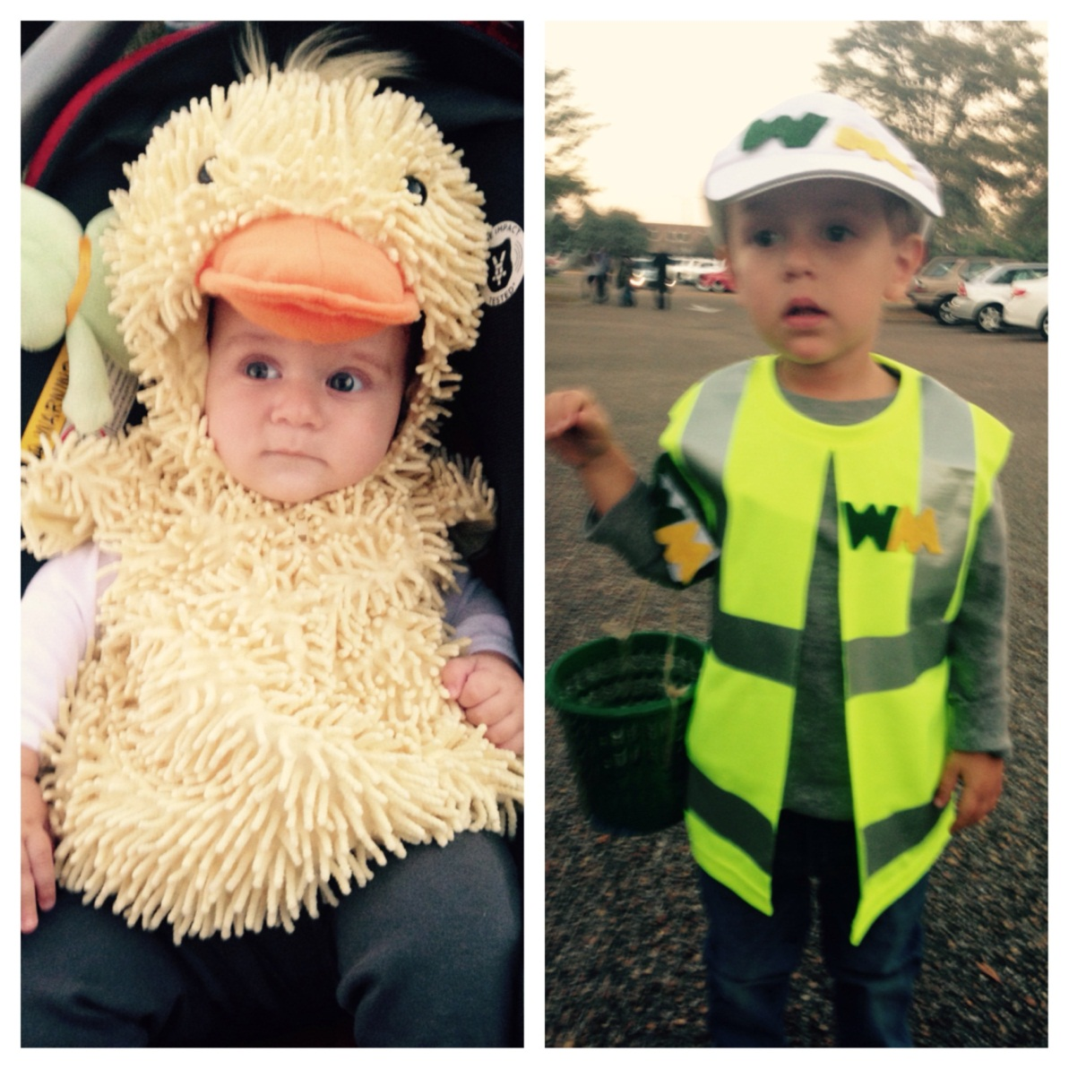
Redirect
Rehabilitate a witness
Explain/correct inconsistencies
Develop new matters discussed on cross
Outside the scope?
Don’t just rehash direct
Notes:
Take a look at R.C.M. 807 Discussion section, what is listed under A, B, C, etc in the discussion section?
Who gives the oath to the witnesses?
What about defense witnesses?
Take control of the witness, give him the oath, stand in front of the witness and make that witness swear to tell you the truth. You’ll hear throughout the MJ lectures and probably from the STCs you work with, take control of the courtroom. It’s our courtroom, our evidence, our case…same thing with WIT oaths.
Memorize this oath and to start, let’s recite it.

Slide 17
Cross Examination

Slide 18
Overview
MRE 611
Preparation
Types of Cross Examinations
Cross Examination Strategies
Crossing the Accused
Conclusion

Slide 19
There’s a rule!
MRE 611(b): Cross-examination should be limited to the subject matter of the direct examination and matters affecting the credibility of the witness
MRE 611(c): Ordinarily leading questions should be permitted on cross-examinations

Slide 20
Stop me if you’ve heard this…
Investigate!
Review all prior statements (have handy)
4 Copies of Statements
Notes – (statement, page and line number)
Pretrial interviews
Details, Details, Details
Statements by the accused
Opinion of charges
Identify Goals/Points

Slide 21
“Rules”
Lead – Statements not questions
Begin and end strong (primacy and recency)
Small portions/simple questions
KNOW the facts, and KNOW the answer
Avoid repetition – don’t repeat direct
YOU are in control
DO NOT ARGUE with witness
Wait for witness to give you permission to destroy them
Don’t ask “the one question too many.”
Leave conclusion for argument
Notes:
Knife example from Brocket case…

Slide 22
Cross–Examination Types
Constructive
Destructive/Impeachment
Ability to observe, remember, or relate
Bias, motive to fabricate, inconsistent statement
Nonexistent – Silent Cross

Slide 23
Constructive
Opposing witness has information to support your case
Elicit facts confirming elements
Bolster your case-in-chief witnesses by drawing absence of bias
In closing, note that defense called the witness:
“Even the defense’s witness confirms…”

Slide 24
Strategy – Discrediting Cross
Point out what witness does not know/did not see
Contradict with stronger information from your witnesses
Attacking/Impeaching a witness who harms your case
Notes:
Does it bother you that David Rocamontes lied to you in his sworn, written statement to you when he told you he did not have her consistently, but his wife, also the active duty Air Force member, did a written statement where she said he babysat the child for four hours a day, every day for two months? Does it bother you that he lied to you?
A. Well, if there is an inconsistency in the statement, it could be someone misremembering as well. So…
Q. Right, and this remembering one to two times instead of every day for two months could be -- you are right, it could be, right?
A. I do not believe that Megan was the one that usually did the babysitting. So, her memory might not be as accurate as Mr. Rocamontes.
Q. Right. She might not remember that her husband was babysitting someone else’s infant for two months. You are right. Okay. Now, you certainly aware of the blotter entries here in Cheyenne about David Rocamontes, right? You are aware of those, right? The blotter entries -- you’ve seen them.
A. No, I have not seen them.
Q. You have not seen the blotter entries?
A. No.
Q. Did you know that approximately a week after the 25th of May, when Serenity was taken out of the home that David Rocamontes -- They attempted to apprehend him because of domestic violence in the home, in the Rocamontes home, were you aware of that when you ruled him out?
A. I did hear about that actually.
Q. Oh, you did hear about that. So, you heard that they had a fight, that there was shoving, that he flipped over and destroyed a bed, and then when Megan Rocamontes called the police to come to the home that he actually fled the base, jumped over the fence and got all the way to Colorado on foot before they found him? You are aware of all of that?
A. I did not hear that portion.
Q. Oh, so you did not know that when you ruled him out?
A. Right.
Q. And, you did not know that the neighbors were concerned about the bruises and the injuries they were seeing on their three-year-old, Jack, when you ruled David Rocamontes out, right?
A. Would you say that one more time?
Q. You were not aware, when you were ruling David Rocamontes out, that the neighbors had seen bruising on Jack, their three-year-old, and were concerned about it. You did not take that into consideration when you ruled David Rocamontes out did you?
A. I did not know that.
Q. And, you were not aware of it -- right, you were not aware of it?
A. I said I was not aware of it.
Q. It is news to you?
A. I said that I was not aware of it.

Slide 25
Discredit - Competency
Do not have to call witness a liar
3 ways:
Ability to perceive/observe
Ability to remember
Ability to recall and relate in court

Slide 26
Discredit - Impeachment
Prior Inconsistent Statements
3 Cs = Commit, Credit and Confront
You are NOT REFRESHING MEMORY!
Pick right ones
MRE 613 vs. 801(d)(1)(A)
Bias
“The accused is your friend…”
Credibility
“You’ve lied before…”
TO BE CONTINUED…

Slide 27
Strategy – “Classic Format”
Friendly Information
Affirmative Information
Confirm facts helpful to your case (Constructive)
Incontrovertible Information
Damages opponents case but are documented
Be ready to Impeach
Challenging Information
You can back it up but they will not want to concede
Hostile Information
Discredit Their Testimony (Destructive)
End Strong…find a good place to stop and stop

Slide 28
Crossing a Character Witness
MRE 404(a)/MRE 405/MRE 608(a) testimony
Explore/attack foundation
If legally insufficient, make objection/motion in limine
If legally sufficient, attack on cross
Did you know/Have you heard questions
PAUSE

Slide 29
Crossing the Accused
Court Member expectations
What can you really do?
Elements (confirm as many as you can, or basic facts that help you)
Relationships
Inconsistencies
Bias / Motive
U.S. v. Fitzpatrick, 14 M.J. 394 (C.M.A. 1983))
Let the accused talk if he’s not making sense
Notes:
U.S. v. Reiner, 15 M.J. 38 (C.M.A. 1983)
U.S. v. Fields, 15 M.J. 34 (C.M.A. 1983)

Slide 30
Crossing the Accused
Cross with any prior statements made by the accused
If a statement is not admissible b/c of a faulty rights advisement, you may still be able to use it to impeach (MRE 304(b)(1))

Slide 31
Checklist
Are all my questions leading?
General Rule: no more than 3-4 Topics????
Do I know the answer to all of the questions that I am asking?
Are all my questions short, fair and statements?
Am I asking one more question…in other words should I save this point for closing argument?
Notes:
EXAMPLE OF SAVING IT FOR CLOSING – Witness testifies to something that is clearly false or wrong. You have several witness that will directly contradict it. Why cross and give them a chance to explain.

Slide 32
OSI Interview
Like I said, what you say here stays with us. We don't go around telling everyone what you say and everything else.
With that, you need to define everything that is going on. Based off of what I am seeing is I think you know more, you just don't want to come out and say what is actually going on. You don't have to worry about anything you say with us.
I am not going to tell anybody about –
See, the thing about our office here is when we talk to people, we don't share information with other people.

Slide 33
OSI Interview
Everything that stays in this room, stays in this room. Okay. A lot of people that I have personally spoken with are afraid that they are going to get judged for something, which I can understand. Being judged is a big burden. I don't judge anybody; it would be biased for us to judge anybody. I have see a lot, okay. You have to understand where I am coming from, because I understand where you are coming from too.

Slide 34
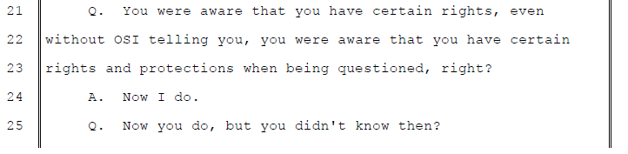
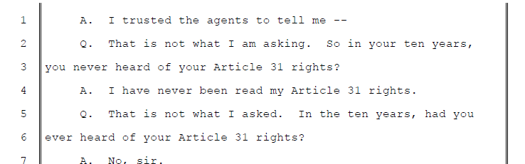
Control by Listening

Slide 35
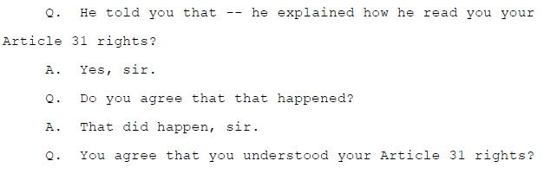
One Topic - Control

Slide 36
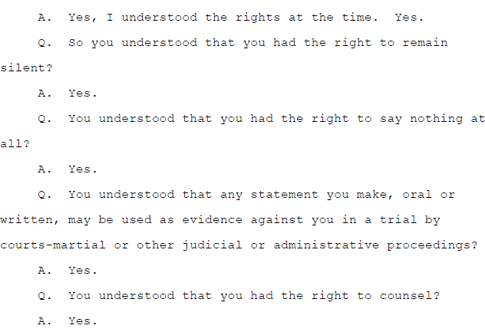
One Topic - Control

Slide 37
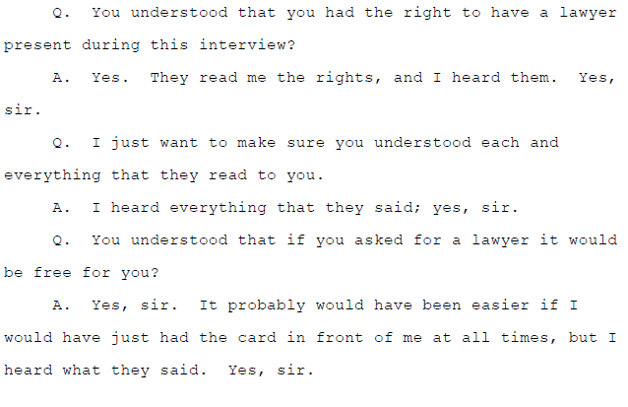
One Topic - Control

Slide 38
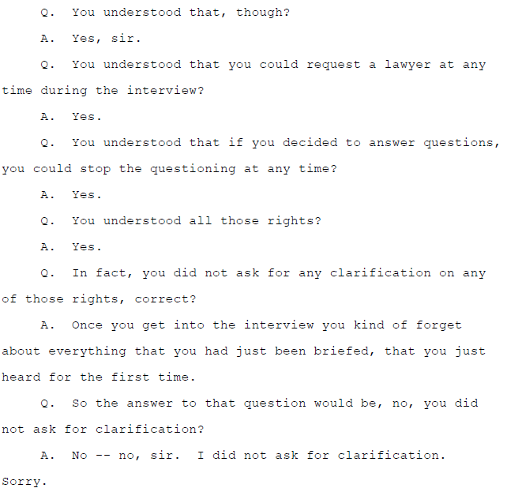
One Topic - Control

Slide 39

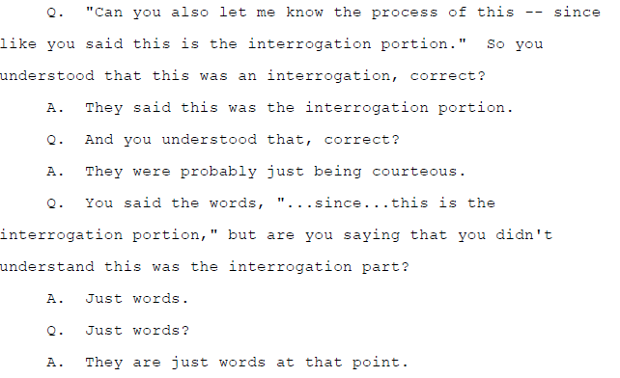
Use evidence – let him talk

Slide 40
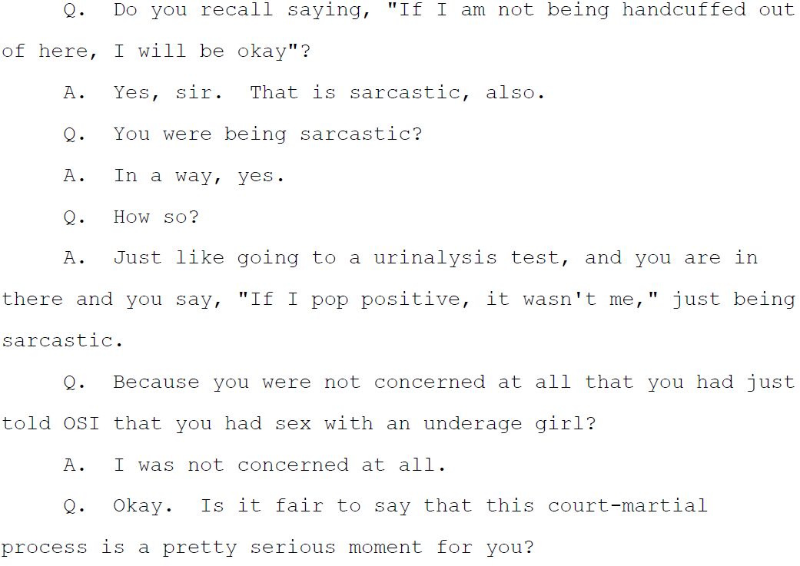

Slide 41
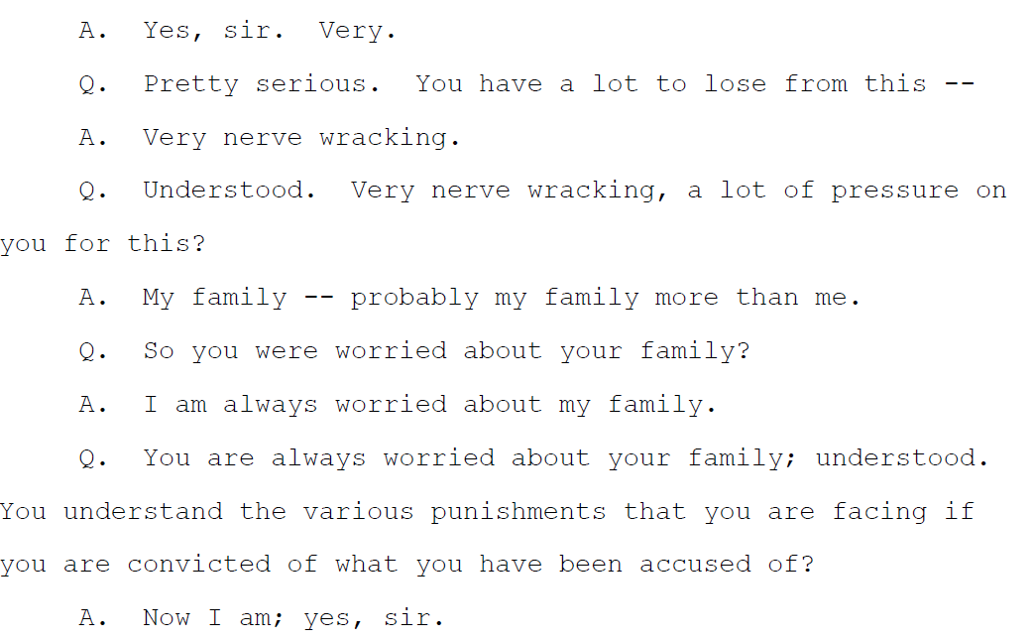

Slide 42

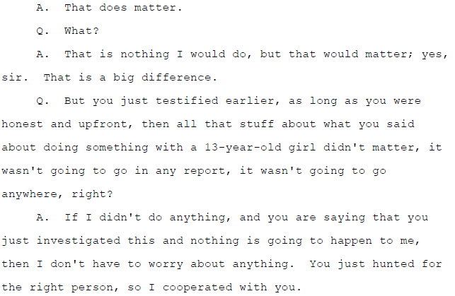
Question too many or don’t care?

Slide 43
Question too many or don’t care?

Slide 44
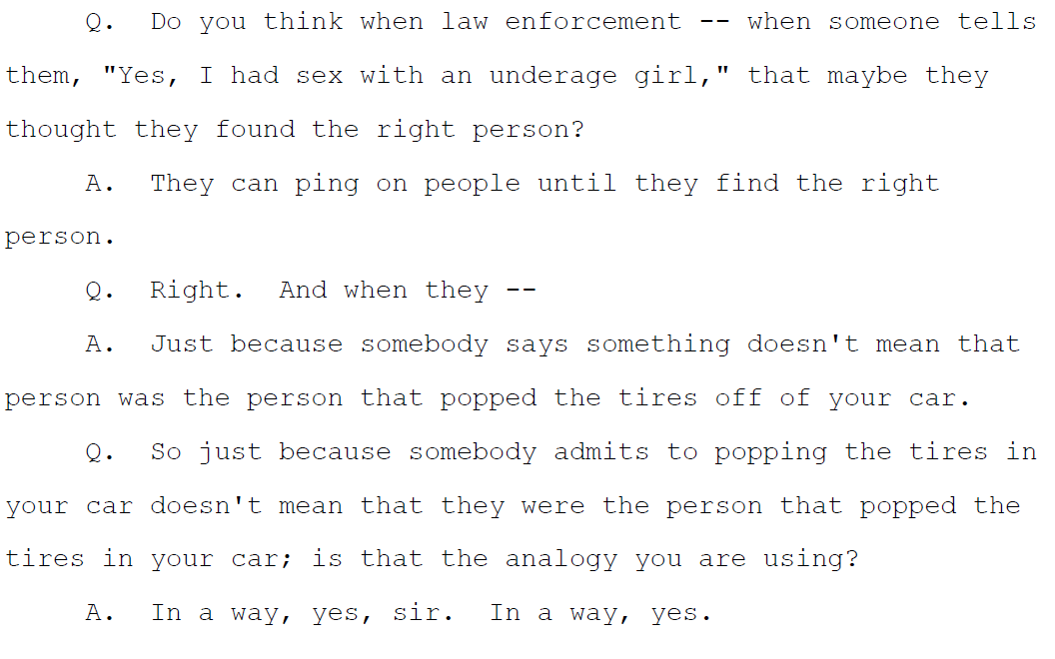
Question too many or don’t care?

Slide 45
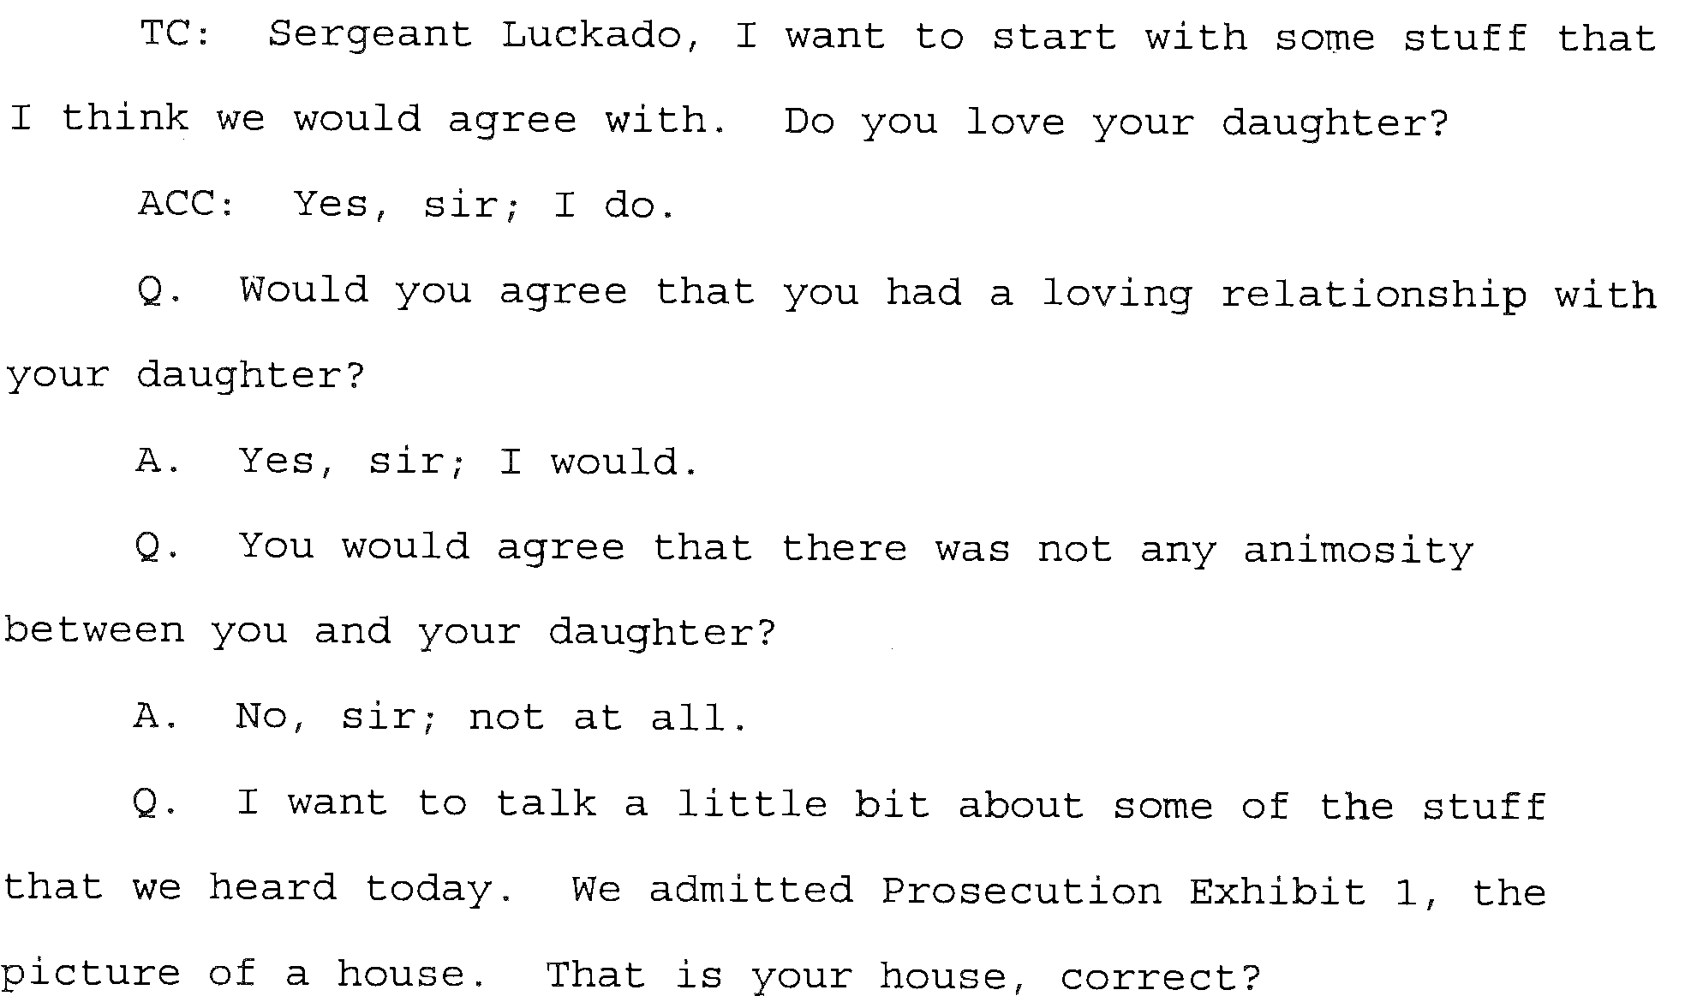
US v. Luckado – OK Start

Slide 46
DEMO???
Notes:
Take a look at R.C.M. 807 Discussion section, what is listed under A, B, C, etc in the discussion section?
Who gives the oath to the witnesses?
What about defense witnesses?
Take control of the witness, give him the oath, stand in front of the witness and make that witness swear to tell you the truth. You’ll hear throughout the MJ lectures and probably from the STCs you work with, take control of the courtroom. It’s our courtroom, our evidence, our case…same thing with WIT oaths.
Memorize this oath and to start, let’s recite it.

